Slide 1


DEPARTMENT OF ELECTRONICS AND COMMUNICATION ENGINEERING
DRIVING ALERT SYSTEM
BY :
SARAVANAN A 210421106085
SARAN RAJ S 210421106084
SUJARITH J 210421106102
VASANTHA RUBAN 210421106118

Slide 2

CONTENT
Problem statement
Objective
Block Diagram
Literature review
Proposed Model
Working Mechanism
Constraints
Technology Stacks
Conclusion

Slide 3
PROBLEM STATEMENT
Number of vehicles on the road continues to increase, there is a growing need for advanced driving alert systems to enhance road safety. Such systems are crucial for preventing accidents, reducing driver distractions, and ensuring overall road safety. The problem statement is to design and develop an advanced driving alert system that can provide real-time warnings and assistance to drivers in various driving scenario.

Slide 4
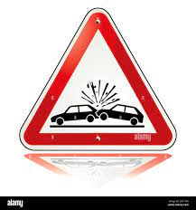
OBJECTIVE
The proliferation of vehicles on the road and the escalating risks associated with modern traffic environments necessitate the development of an Advanced Driving Alert System. This system is designed to harness cutting-edge technology to enhance road safety, mitigate accidents, minimize driver distractions, and ultimately safeguard lives. The primary objective of this project is to create an intelligent and adaptable system that provides real-time warnings and assistance to drivers in diverse driving scenarios.

Slide 5
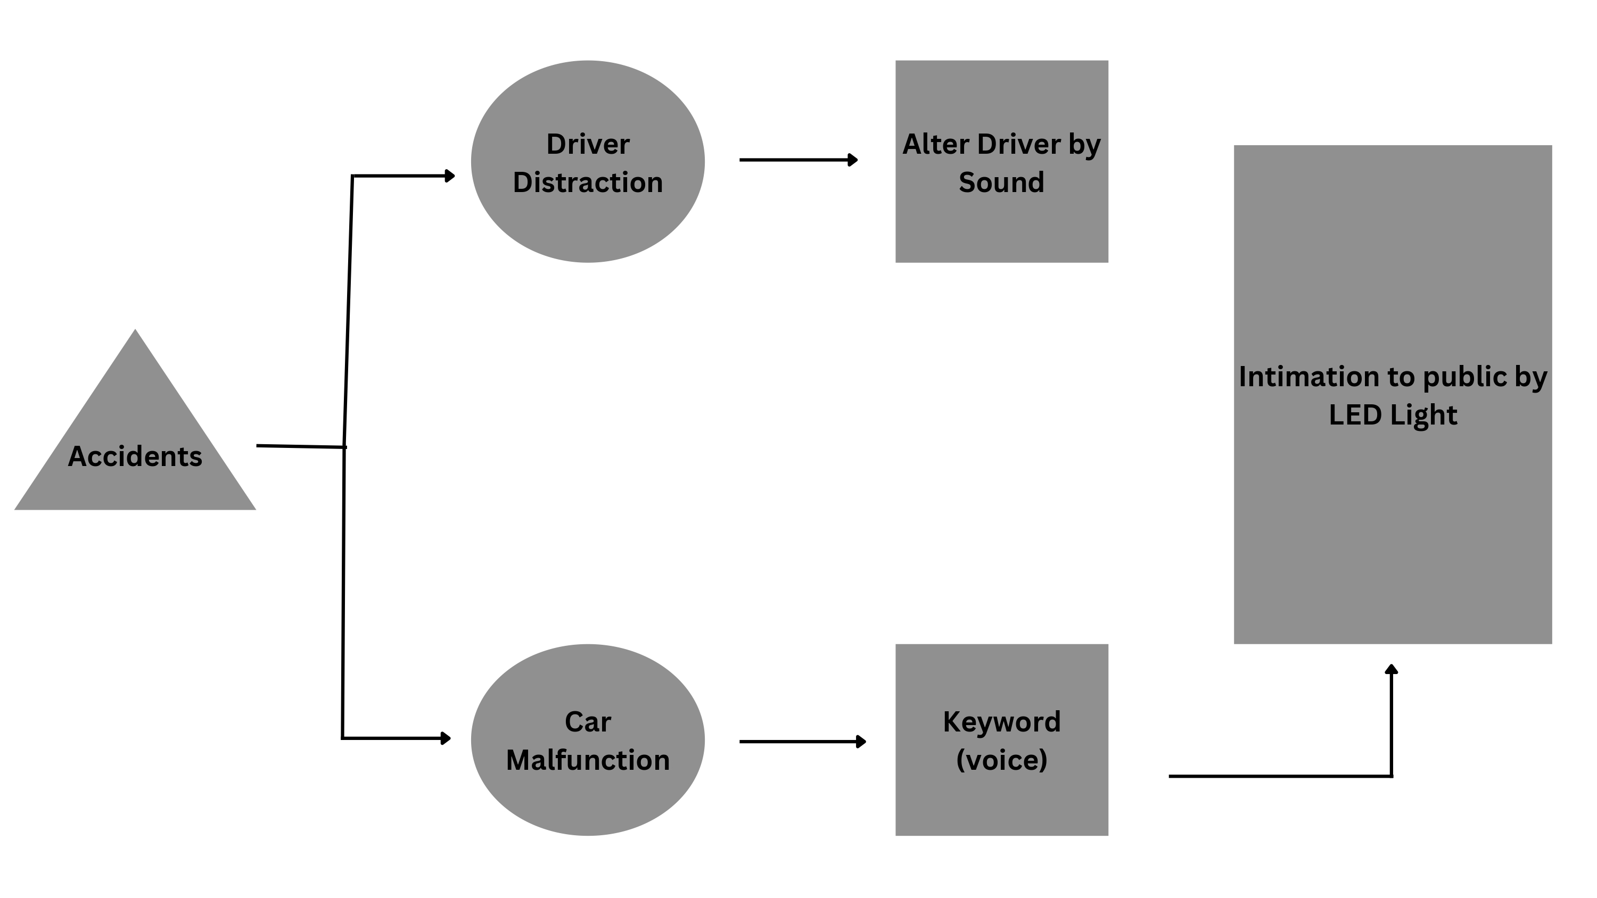
BLOCK DIAGRAM

Slide 6
REFERENCE
1. Chin-Teng Lin, Chun-Hsiang Chuang Chih-Sheng Huang, Shu-Fang Tsai, Shao-Wei
Lu, Yen-Hsuan Chen, et al., "Wireless and Wearable EEG System for Evaluating
Driver Vigilance", IEEE Transactions Biomedical Circuits and Systems, vol. 8, no. 2,
April 2014..
2. Nadeem Akhtar, Kush Pandey and Saurabh Gupta, "Mobile Application For Safe
Driving", Fourth International Conference on Communication Systems and Network
Technologies, 2014.
3. J. Dai, J. Teng, X. Bai, Z. Shen and D. Xuan, "Mobile phone based drunk driving
detection", 4th International Conference on Pervasive Computing Technologies for
Health-care Munich 2010, pp. 1-8, 2010.

Slide 7
LITERATURE REVIEW
ADAS and Active Safety: Continuous interaction between the driver and an Advanced Driver Assistance System (ADAS) is vital for improving active safety in vehicles.
Multiple Alert Types: ADAS employs various alert methods, such as visual, audio, and vibrational alerts, to communicate safety information to the driver.
Voice Alerts' Limitation: Although voice alerts are effective, they can be less effective when the driver's mood is abnormal or concentration levels are low.
Adaptive Voice Alert System: To address this limitation, an adaptive voice alert system is proposed. It adjusts voice alerts based on the driver's cognitive state to improve their effectiveness.
Enhanced Vehicle Safety: The goal of the adaptive voice alert system is to enhance the effectiveness of voice-enabled Human Machine Interface (HMI), ultimately leading to improved vehicle safety.

Slide 8
PROPOSED WORK:
Voice Input: The system continuously listens for voice commands using voice recognition.
Trigger Event Detection: Sensors like accelerometers monitor vehicle movements for sudden deceleration or collisions.
Voice Command Recognition: When an emergency is detected, the system processes voice commands like "Help" or "Emergency.“
Emergency Alert Activation: Valid commands trigger LED light alerts for visual notification.
LED Alert Patterns: LED lights display various patterns or colors to indicate the severity of the emergency.
Communication: Optionally, the system can be linked to a communication module to notify emergency services or pre-defined contacts and activate safety features.
Manual Activation: A manual override button allows users to trigger LED alerts if voice recognition fails.
Reset and Acknowledgment: After resolving the emergency, the system provides a way to reset or acknowledge alerts to prevent continuous alerts

Slide 9

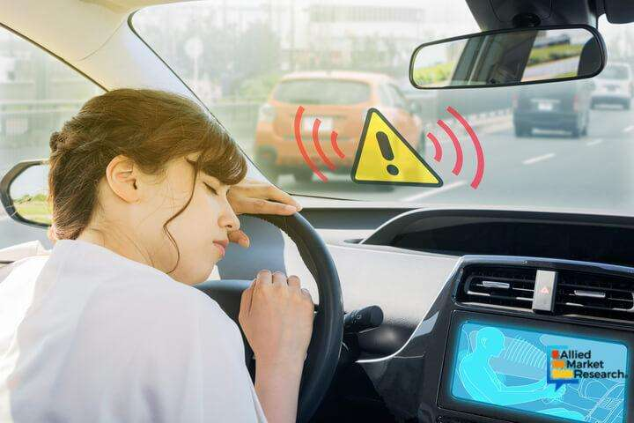

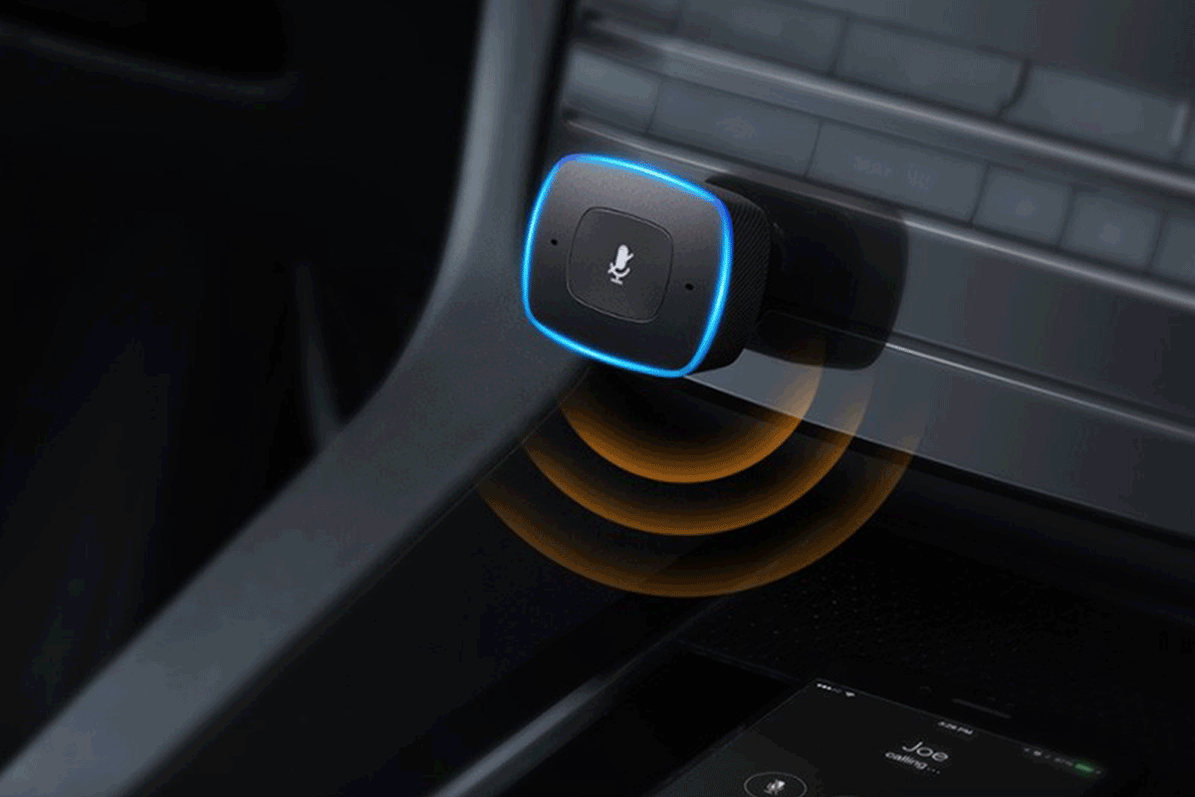
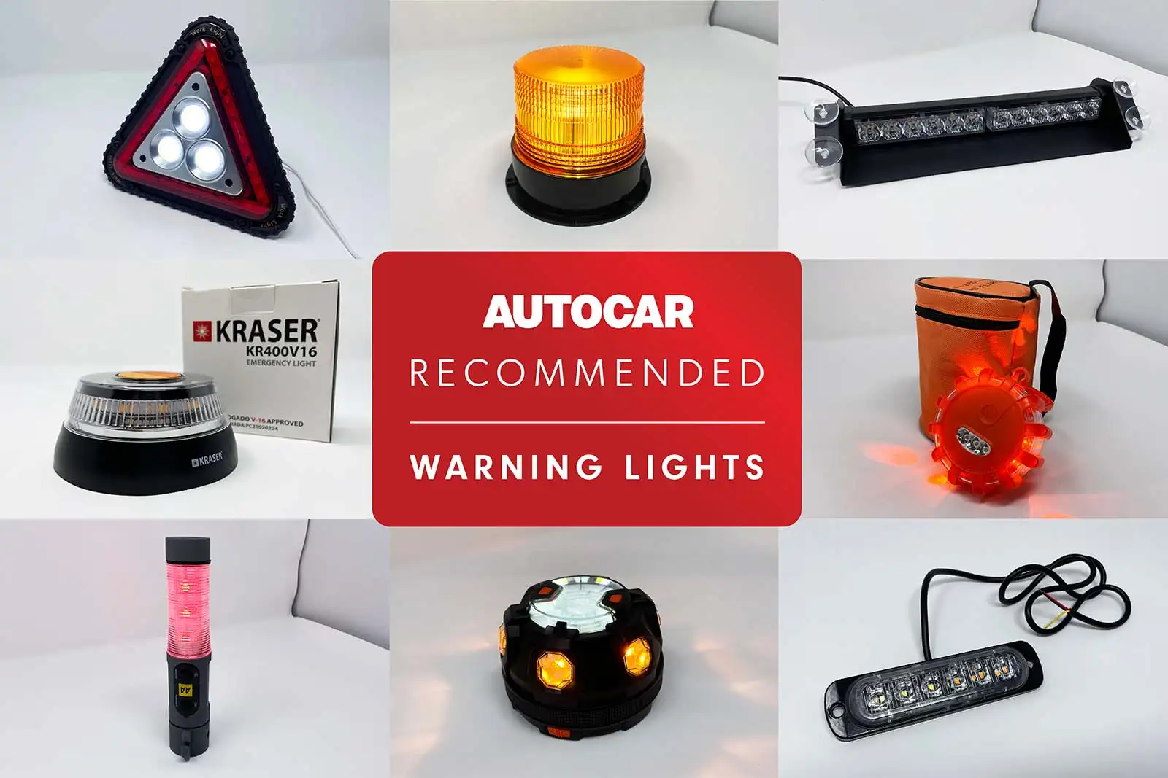
WORKING MECHANISM

Slide 10
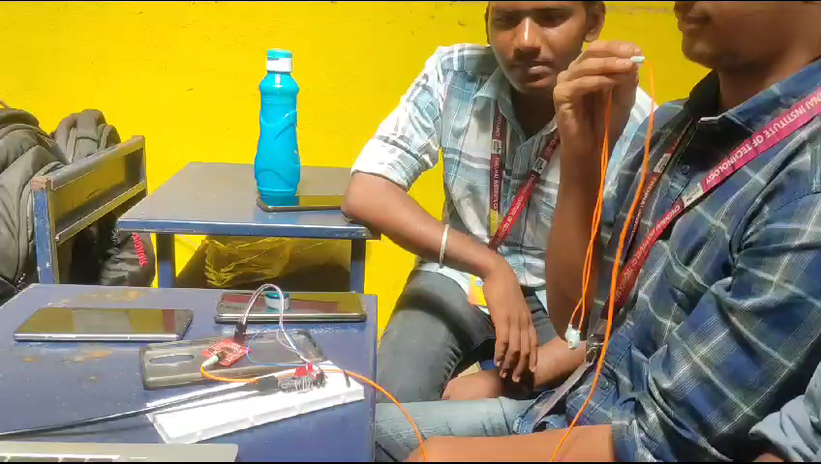

Slide 11
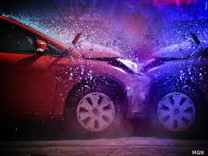
CONSTRAINTS
The system should not cause additional distractions for the driver.
The system should be cost-effective and affordable for a wide range of vehicles.
The system should be adaptable to different types of vehicles (e.g., cars, trucks, motorcycles).
Consider the limitations of existing hardware and sensor technologies available for integration.
Ensure that the system operates reliably in various weather and lighting conditions.
Comply with all relevant legal and regulatory requirements, including privacy laws.

Slide 12
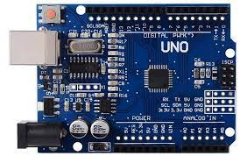
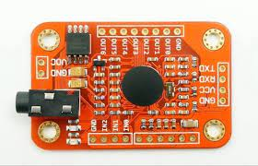
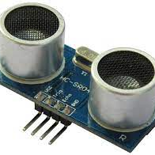
TECHNOLOGY STACKS
Voice Recognition Module
Ultrasonic sensor
Arduino

Slide 13
CONCLUSION
Driver fatigue alert (8-second hand-off detection) with alerts.
Accident detection with automatic activation of LED warning lights.
Driver behavior monitoring for improving safe driving habits.
LED warning light make other pedestrians to contact emergency service communication.
Potential future integration with GPS for precise location notification in emergencies.

Slide 14
Thank you!

